Slide 1
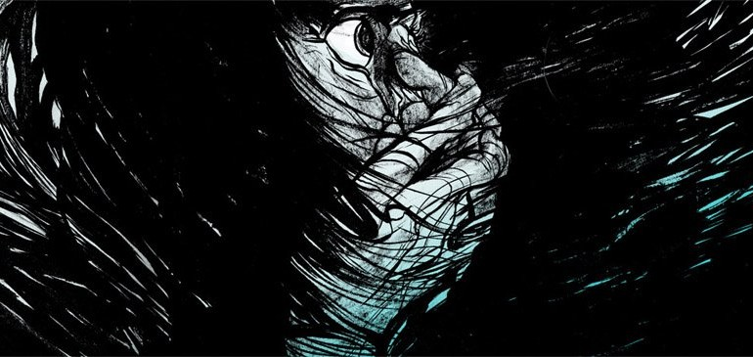
“FEAR”

Slide 2
“FEAR”
Design a picture that conceptualizes the word fear. Think about ideas associated with the act of being afraid, phobias, what it feels like to be in a state of fear or emotional struggles. Avoid being too literal. You want to viewer to be able to interpret after they have some time to analyze it.

Slide 3
“Fear”

Slide 4
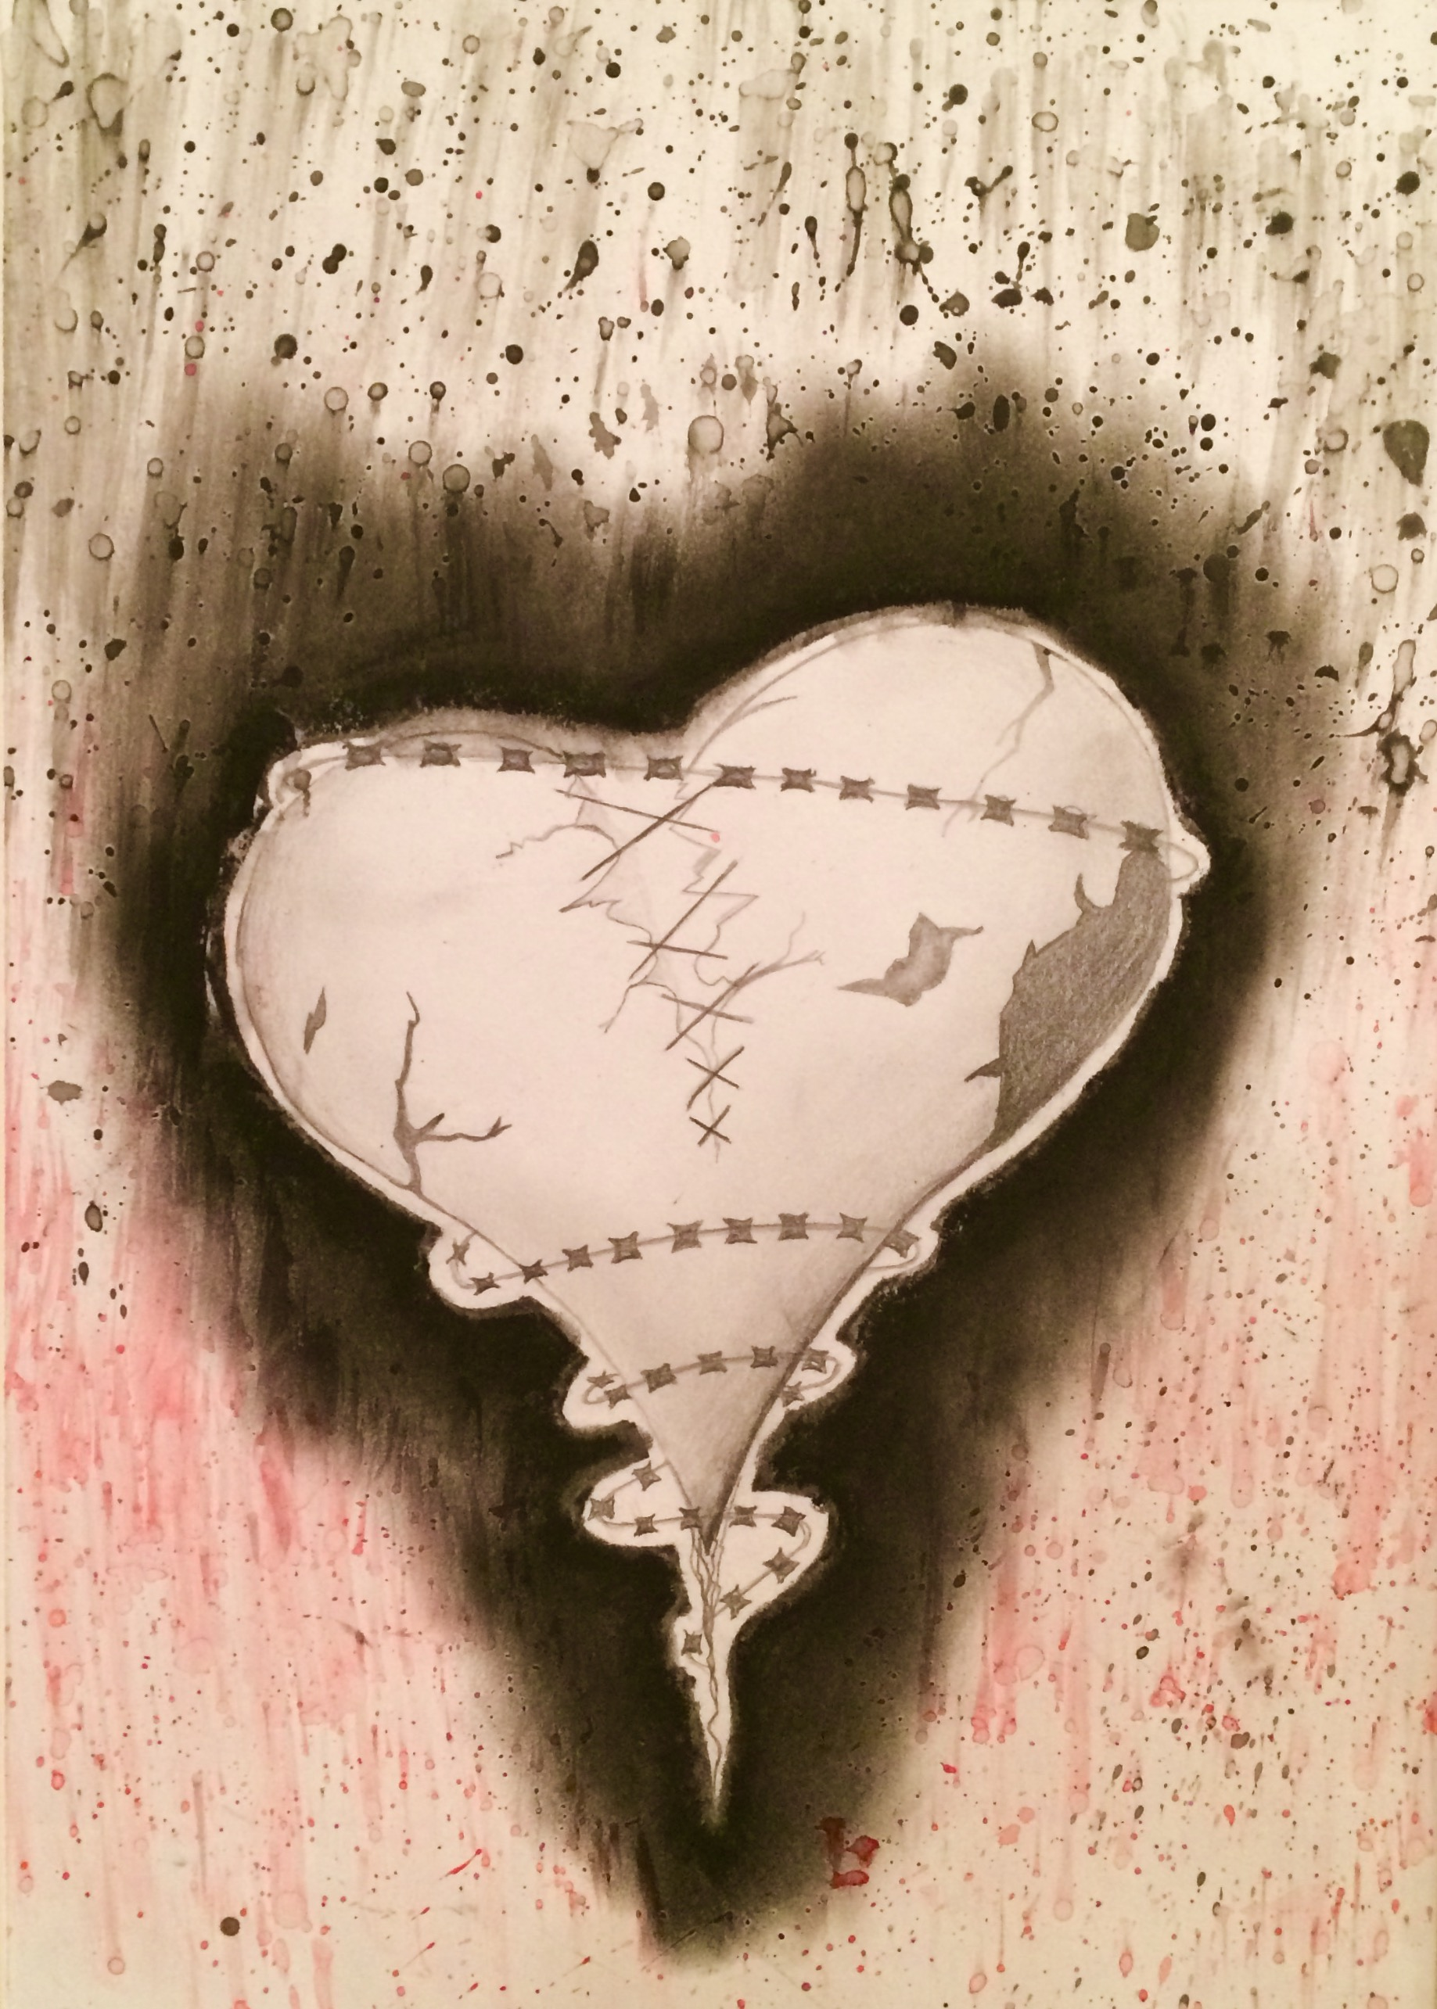
Student examples

Slide 5
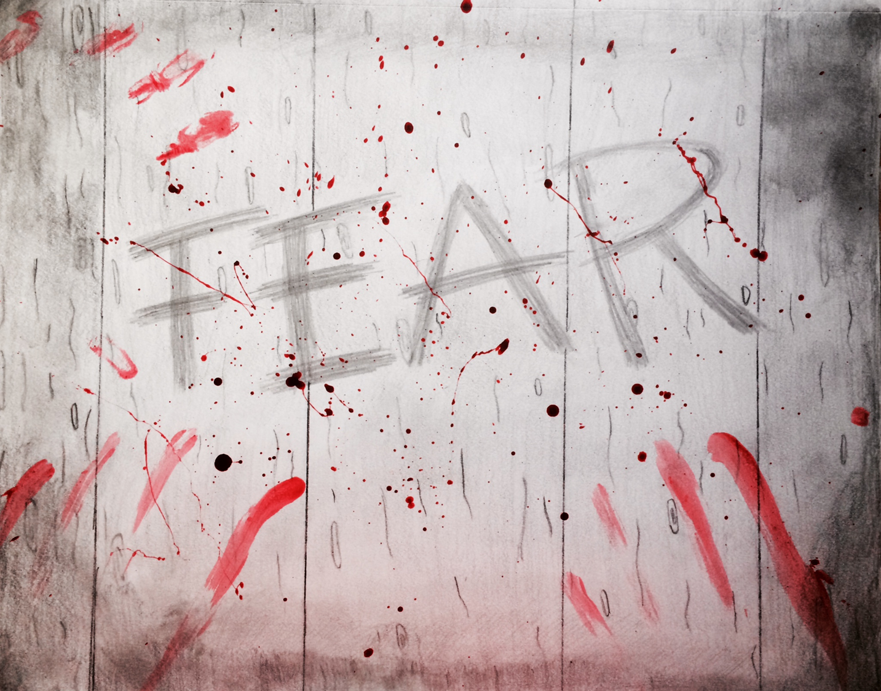
Student Examples

Slide 6
Tips to improving your grade
Think about the mood and tone of the word fear. Dark, heavy contrast is key in this assignment
Point of view… people fear things that are behind, below and around things. Putting something smack in the middle of the page is too predictable
Think outside the box! There are many connotations to the word fear. Try to get inspired by yourself or someone you know

